Slide 1
Parkinson Disease Rehabilitation
Naïve Bayes
k-Nearest Neighbors

Slide 2
Parkinson’s disease
Parkinson disease (PD) is a chronic neurodegenerative disorder, affect nerve cells in the brain that produce dopamine. It is estimated there are at least 100 PD subjects per 100,000 in the population, and some studies have suggested PD prevalence may be underestimated.
Parkinson’s disease symptoms include muscle rigidity, tremors, and changes in speech and gait. After diagnosis, treatments can help relieve symptoms, but sadly no cure.
Vocal impairment is reported in the vast majority of PD subjects, and approximately 29% of those consider it one of their greatest hindrances associated with the disease. Typical vocal impairment symptoms include reduced loudness, monotone, hoarseness, breathiness (noise), imprecise articulation and vocal tremor. The extent of vocal impairment can be assessed using sustained vowel phonations, or running speech.

Slide 3
Lee Silverman Voice Treatment System
We are building a LSVT system that would help assets the vocal performance as acceptable or unacceptable(binary classification).
The two classifiers used are Naïve Bayes and - and is a binary classier; meaning that we have only 2 classes to decide between: The required system needs to state whether the patient’s voice is acceptable or unacceptable.

Slide 4
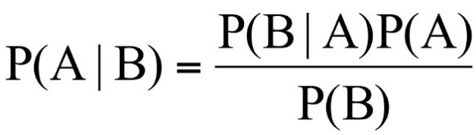
Naïve Bayes

Slide 5
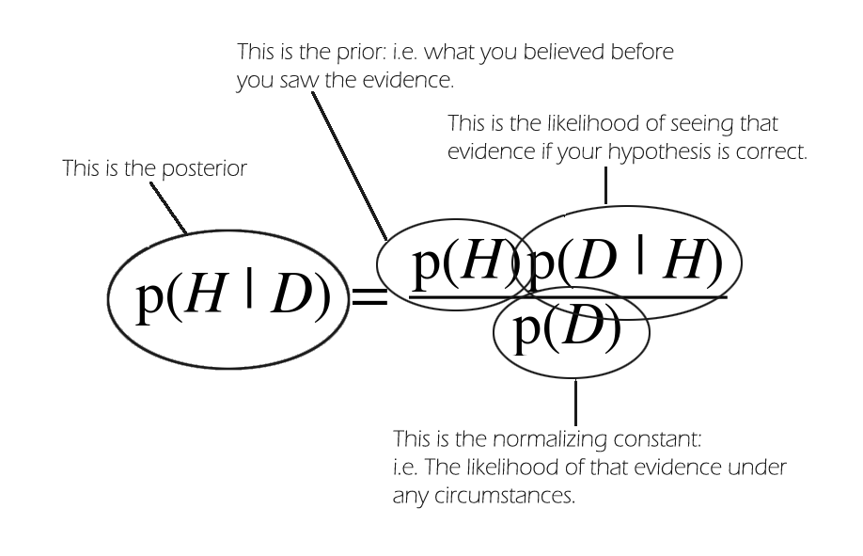
Theorem

Slide 6
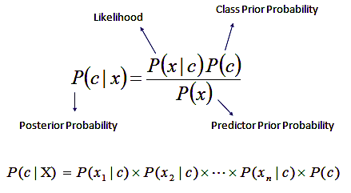
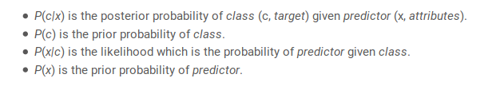

Slide 7
Code
Read Data Set
Extract 4 features (Energy - 4thPower – Nonlinear Energy – Curve Length)
Using CV Partition (Kfold – 2 partitions) to work on my data in two different ways/partitions

Slide 8
Train Stage
In each partition:
Divide data, Train and Test matrices
Get Class1, accepted, and Class 2, unaccepted, probabilities from test matrix
Divide train into two matrices, trained C1 & C2, depending on accepted and unaccepted value(1 or 2)
Calculate mean and standard deviation of each feature column in both trained class 1 and 2
*Now our training stage has ended and we can start testing out our test matrix

Slide 9
Test Stage
Use normpdf function to get probability of a feature given a class1 once and class2 as a next step
Get probability of all features given class1 and then given class2
Compare the 2 probabilities and accordingly build your predicted array
Use confusion matrix to compare between actual and predicted, consequently conclude our true positive, true negative, false positive, false negative values

Slide 10
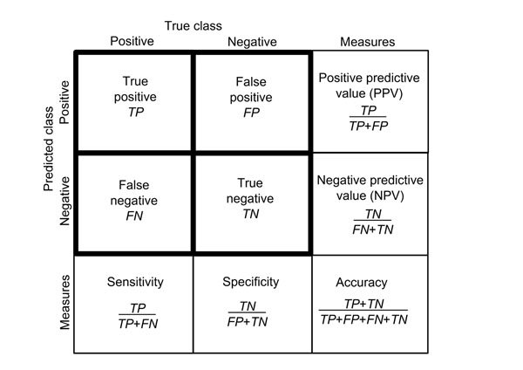
Test Stage
Calculate accuracy, sensitivity, and specificity accordingly

Slide 11
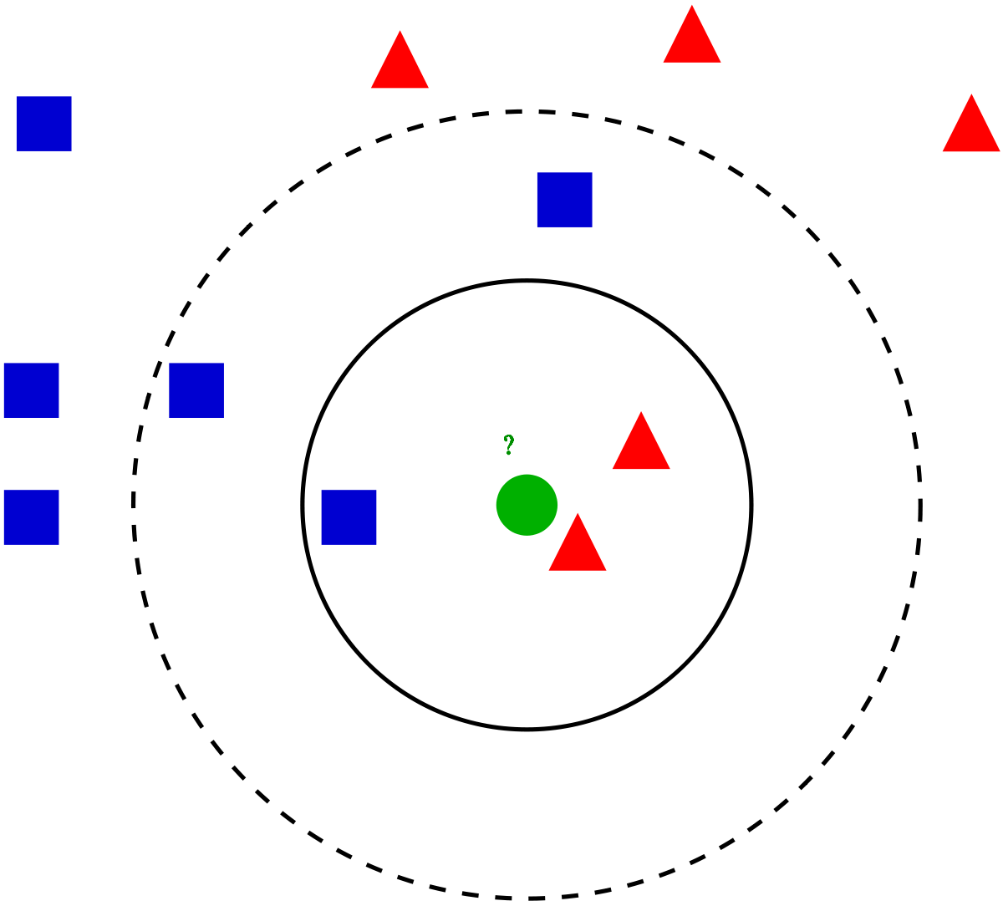
k-Nearest Neighbors

Slide 12
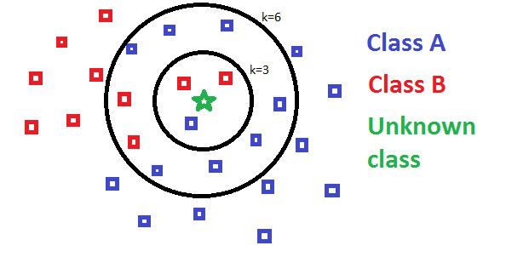
Theorem

Slide 13
Code
Read Data Set
Extract 4 features (Energy - 4thPower – Nonlinear Energy – Curve Length)
Split data into 100 train and 26 test samples
Use KnnClassify function to get predicted array
Use confusion matrix to compare between actual and predicted, consequently conclude our true positive, true negative, false positive, false negative values and accordingly calculate accuracy, sensitivity, and specificity

Slide 14
KNN Vs NB Comparison
KNN's decision boundary can take on any form makes no assumption about the data distribution. Contrast this to NB, which assumes that attributes are conditionally independent to each other given the class, and are normally distributed (for real-valued attributes).
Naive Bayes can be fooled by correlated attributes Imagine we have two attributes, A and B, and assume a two-class classification problem. Suppose that P(A|C1) = P(A|C2) and P(B|C1) = P(B|C2); that is marginal distributions of A and B in both classes are the same. In this case, NB can't classify data points as it relies on marginal distribution of attributes given class to do classification. If the distinguishing characteristic for classification is not the marginal distributions but correlation, then NB won't be a good choice. An example is when in class 1 A is positively correlated with B whereas in class 2 they are negatively correlated.

Slide 15
Algorithm | Problem Type | Easy to explain algorithm to others? | Average predictive accuracy Automatically learns feature interactions? | Training speed | Performs well with small number of observations? | Handles lots of irrelevant features well (separates signal from noise)? | Parametric?
KNN | Regression Classification | Yes | Low | Fast | No | No | No
Naïve Bayes | Classification | Somewhat | Low | Fast (excluding feature extraction) | Yes | Yes | Yes

Slide 16
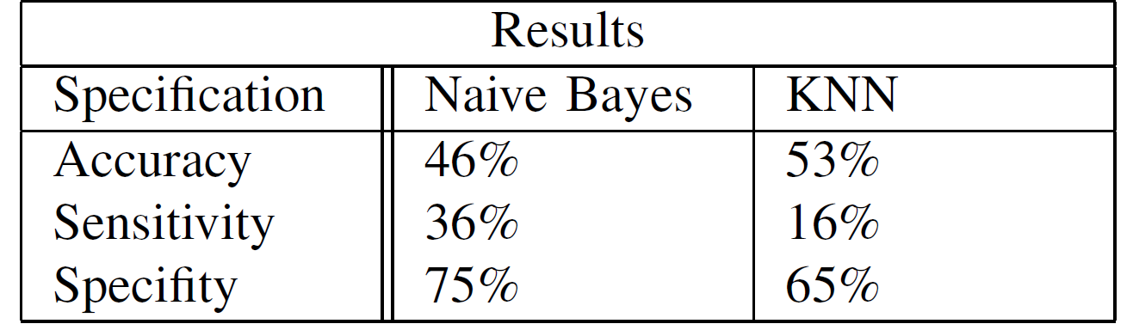
Our Results

Slide 17
References
https://www.youtube.com/watch?v=EFbYLc5ARtM
https://www.dataschool.io/comparing-supervised-learning-algorithms/
https://www.quora.com/Classification-machine-learning-When-should-I-use-a-K-NN-classifier-over-a-Naive-Bayes-classifier
https://people.maths.ox.ac.uk/tsanas/Preprints/TNSRE2013.pdf

